Slide 1
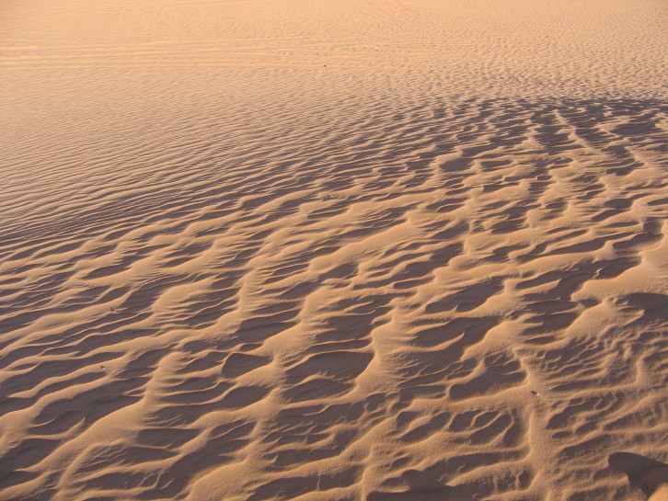
Tell me the good news about the end of the world
Reflections of a climate change consultant
Nick Brooks
Garama 3C Ltd
nb@garama.co.uk
www.garama.co.uk
nickbrooks.org

Slide 2
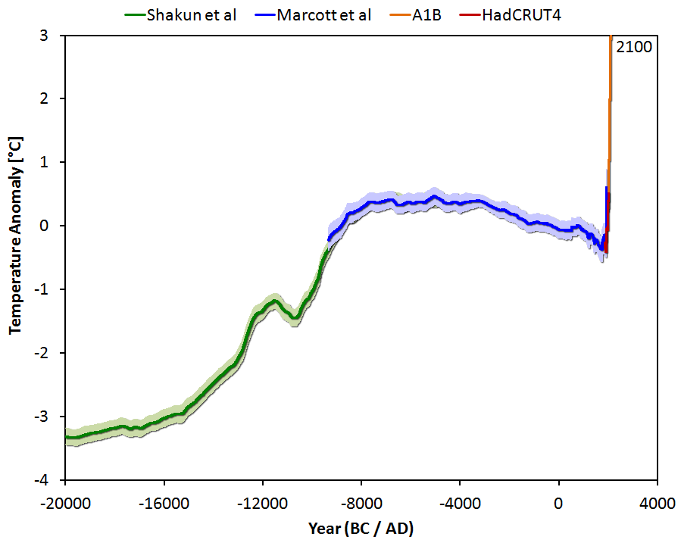
Well, the end of a geological era
Pleistocene
Holocene
Anthropocene
Global temperature variation since the last ice age 20,000 years ago, extended until 2100 for a medium emissions scenario with about 3 degrees of global warming. Graph: Jos Hagelaars, via RealClimate: http://www.realclimate.org/index.php/archives/2013/09/paleoclimate-the-end-of-the-holocene/
2

Slide 3
What happened last time?
Middle Holocene Climatic Transition (MHCT) ~6000-5000 yrs ago^{1,2}
Small global cooling of <0.5° C³
Establishment of regular El Niño⁴
‘Neoglaciation’ – glacial advance at high latitudes & altitudes^{1,5}
Aridification of northern hemisphere sub-tropics, African drying^{2,6}
Major cultural transitions across globe – collapse + more complex responses^{2,6,7,8}
Major shifts in livelihoods/production systems^{2,6,7,8}
Large changes in population distributions & densities; increased inequality^{2,8,9}
Invention of civilisation in refugia surrounded by extreme resource scarcity^{2,6}
Palaeolake, Western Sahara, dating from Middle Holocene (Photo: Nick Brooks)
¹Mayewski et al. 2004; ²Brooks 2010; ³Jansen et al. 2007; ⁴Sandweiss et al. 2007; ⁵Thompson et al. 2006,; ⁶Brooks 2006; ⁷Brooks 2013; ⁸Clarke et al. 2015; ⁹Manning et al. 2014,
3

Slide 4
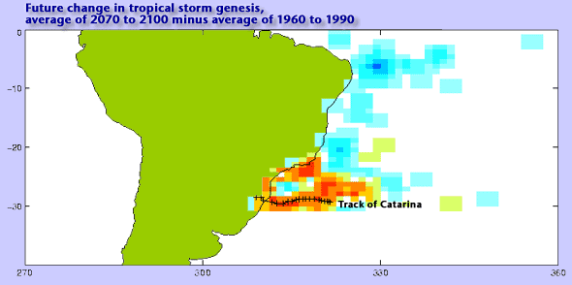
…and what will happen this time?
Changes in climatic variability – rainfall, extremes
Intensification of existing hazards, emergence of new hazards
Shifts in (agro-)ecological zones, desertification, land-loss
Changes in potential/actual ranges of pests, diseases
Changes in viability of production systems, trade, economies, settlements
Changes in commodity prices, food security, poverty, etc.
Changes in some drivers of migration & conflict
Existential threat to some states, societies?
Civilisational collapse, emergence of new social forms? (cf last time…)
Projected tropical storm formation likelihood and track of Hurricane Catarina. Graphic: UK Met Office.
Unprecedented dust storm, Smaara refugee camp, Algeria. Photo: anonymous, via Bachir Mehdi.
http://www.metoffice.gov.uk/weather/tropicalcyclone/catarina.html

Slide 5
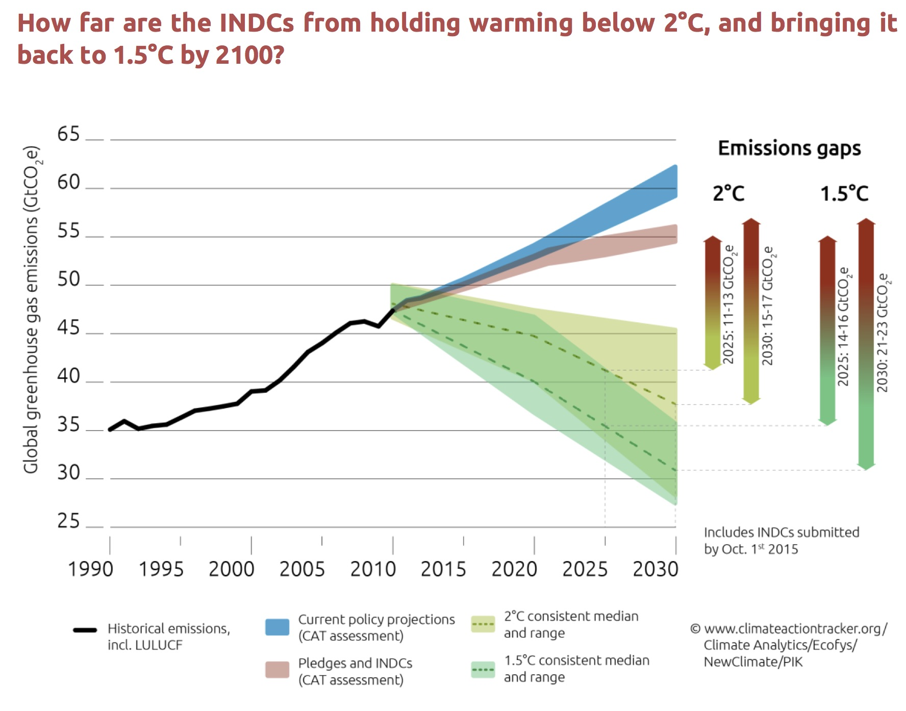
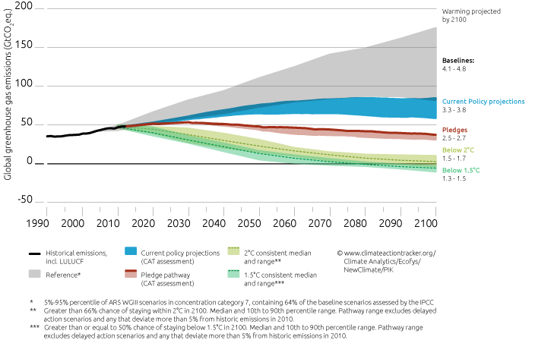
How to respond - mitigation
Recent slowdown in emissions, but slow, incremental changes
COP 21 agreement insufficient to prevent potentially catastrophic global climate change, but much better than expected
Global fossil fuel subsidies falling but still 4x those for renewables
UK domestic energy policy, well…..
Graphics from Climate Action Tracker (http://climateactiontracker.org/): http://climateactiontracker.org/assets/publications/CAT_global_temperature_update_October_2015.pdf

Slide 6
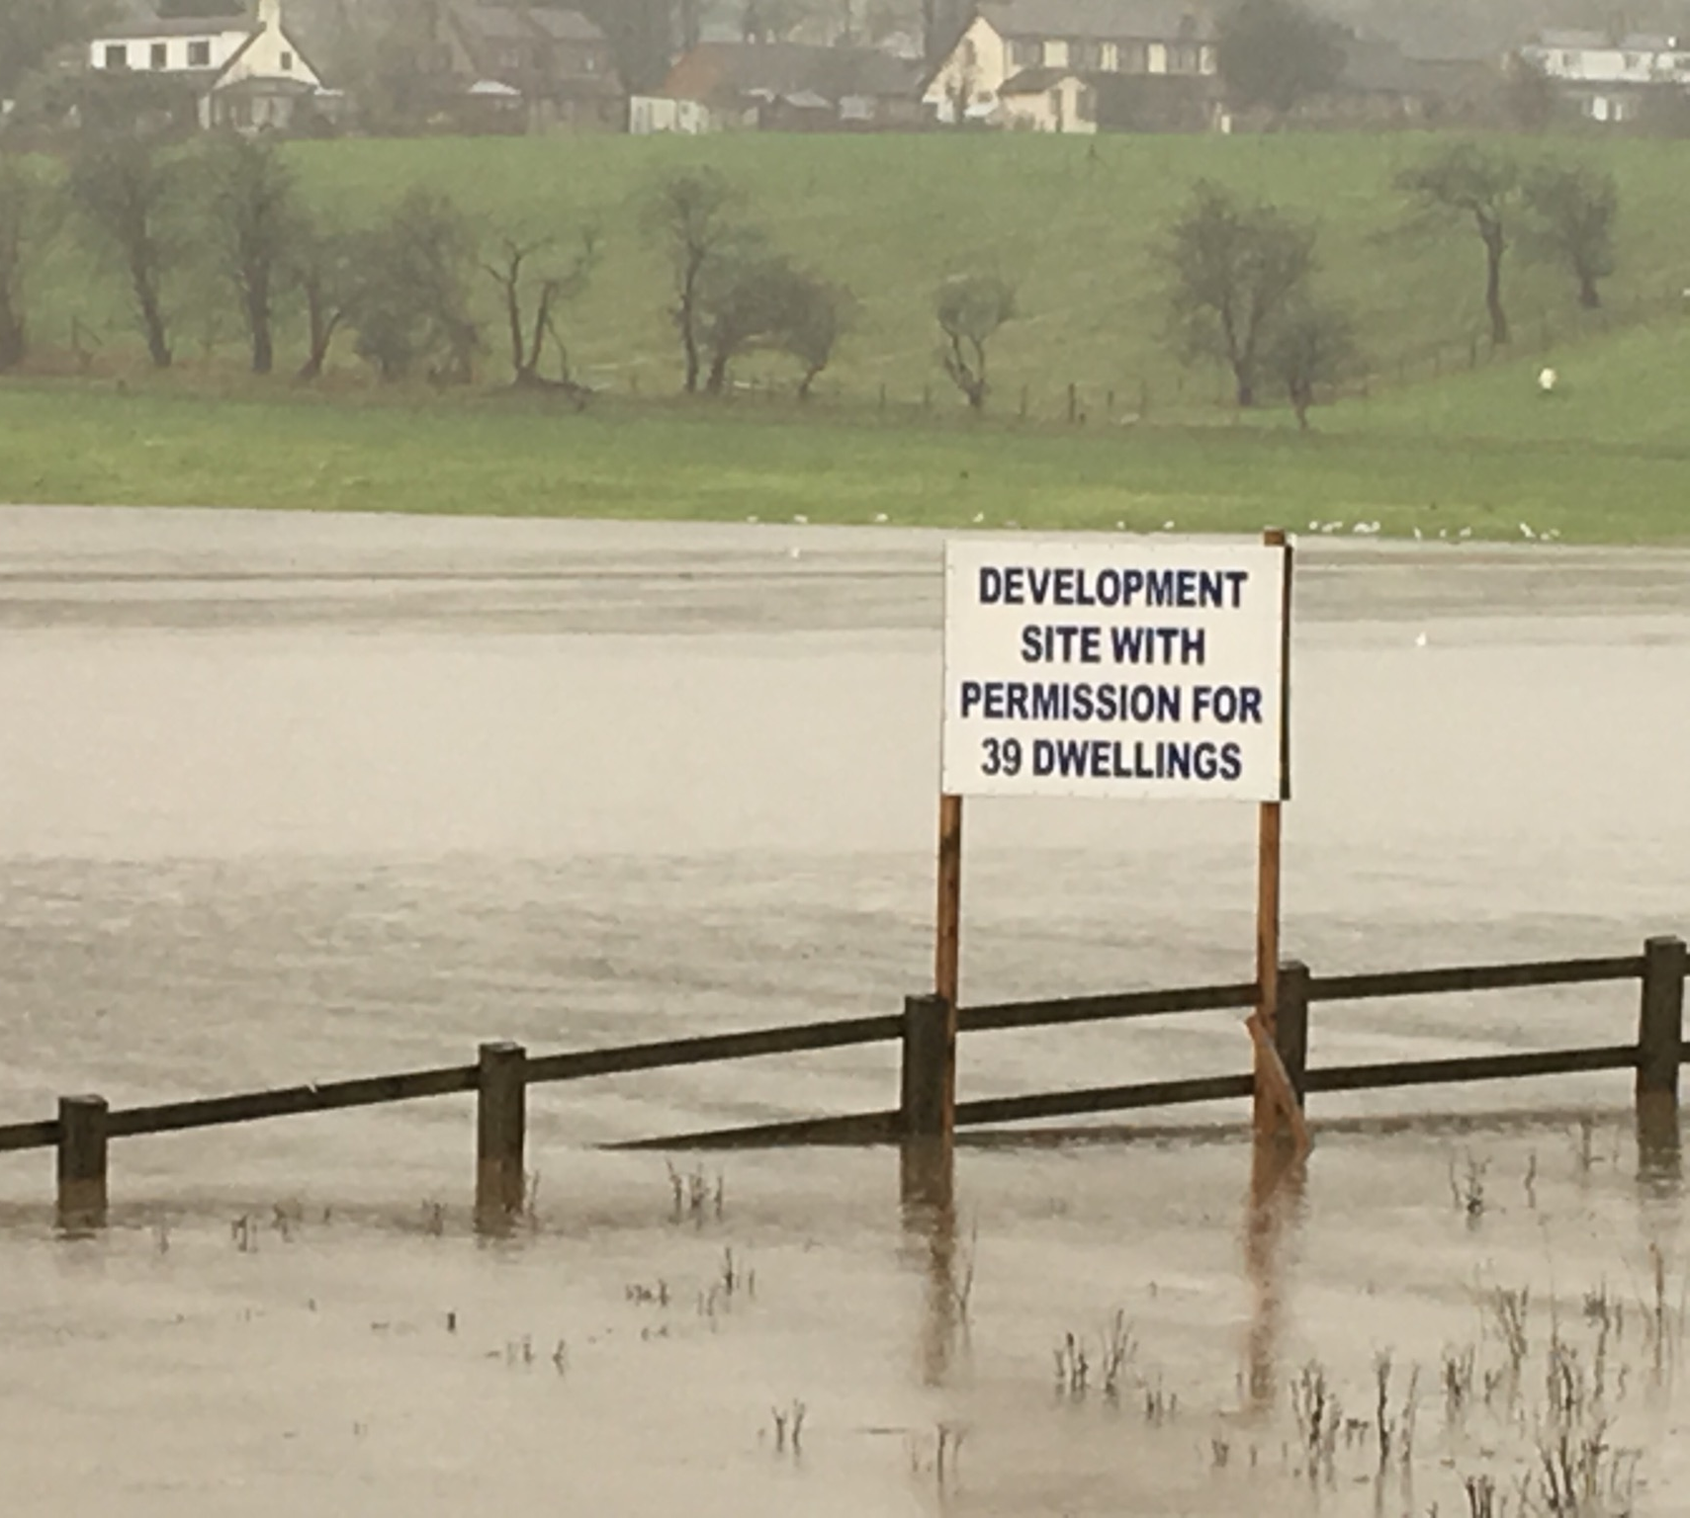
How to respond - adaptation
Incremental adaptation: “Adaptation actions where the central aim is to maintain the essence and integrity of a system or process at a given scale.” (IPCC 2014)
Transformational adaptation: “Adaptation that changes the fundamental attributes of a system in response to climate and its effects.” (IPCC 2014)
However, much development still maladaptive, much adaptation barely incremental – focus on ‘good practice’ in e.g. ’climate smart’ agriculture, but often lip service
UK domestic policy – ignore climate risks
Increased development in flood risk areas (most of 9 LAs) & eroding coastlines (3/4 LAs)
Preferential development of these areas in in 4 and 2 of these LAs respectively
Hard surfacing area increase in 5/6 urban authorities, greenspace declined in all 6 – exacerbate risk & urban heat island effect.
UK Committee on Climate Change. 2011. Adapting to climate change in the UK Measuring progress Adaptation Sub-Committee Progress Report.
Photo from Clitheroe Advertiser, December 2015
Clitheroe Advertiser, December 2015

Slide 7
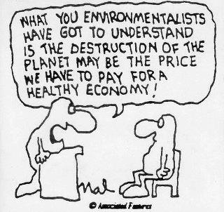
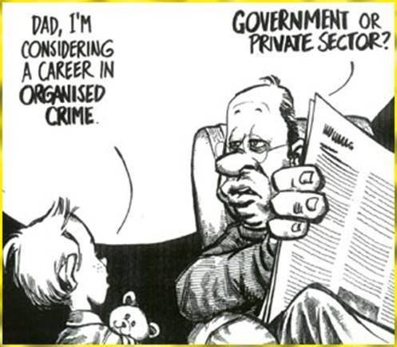
A fundamental problem...
Governments incapable of action outside dominant political/economic models
Audience member: “How is green growth different from sustainable development?” GGGI representative: “Well, green growth is more about the growth.”
Presentation by GGGI at AfDB, 2012
“We could probably do 550 [ppm], but 450 isn’t [politically or economically] realistic”
UK Treasury representative, DEFRA meeting, 2004
Almost anyone from the UK govt: “Where’s the private sector in all this?”

Slide 8
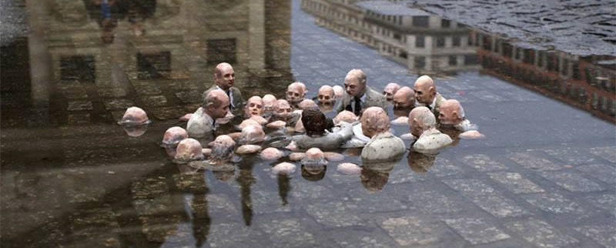
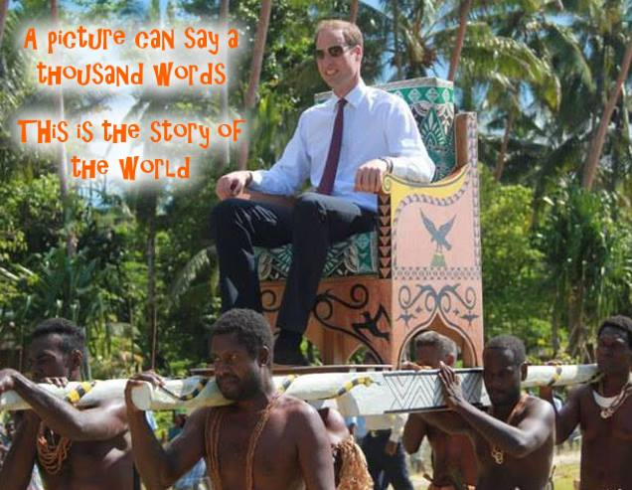
Why is action so difficult?
Decision makers don’t (want to) know how bad it is
“That was very interesting, but I object to the negativity. I want to know the good news about climate change. Where are the opportunities?” DFID representative, 2006
Few know anything about climate science – mostly economics backgrounds
Scientists often reluctant alienate govts. etc. with ‘alarmism’/reality
Over-optimistic representations of mitigation possibilities (Anderson 2015)
Limited ‘buy-in; where decision-makers told to ‘mainstream’ climate change
Structural issues – vested interests, lobbying, elite capture, worldviews
Short timescales associated with political timescales (elections, plans, reviews)
“Politicians Discussing Global Warming”, by Isaac Cordal
The epitome of entrenched power structures. Source unknown

Slide 9
Nonetheless, growing global activity to address CC
Big focus on climate change and international development
Expansion of dedicated climate finance
$100 billion per yr by 2020 under Green Climate Fund (developing countries)
~$30 billion over past few years as ‘Fast Start’ climate finance
100s of billion $ per year in total climate finance (public, private, national, international, rich countries & developing countries)¹
‘Mainstreaming’ of climate change into general development finance
Increasing emphasis on adaptation & resilience (as well as mitigation/ low-carbon development)
Growing desire to know ‘what works’ – how to measure results
Despite UK domestic climate policy meltdown, international spending up
International Climate Fund (ICF): £3.87 (2011-15) to £5.8 billion (2016-2020)
In part to due to ‘ring-fencing’ of overseas development aid (ODA) budget
ODA seen through lenses or reputation, influence, security
¹http://www.climatefinancelandscape.org/. For international climate finance see climatefundsupdate.org

Slide 10
The climate change – development landscape
Key actors
Donor & developing country governments
Multilateral organisations (development banks, UN agencies, OECD, EC, etc.)
Organisations implementing programmes, projects funded by above
Third party organisations – consulting firms, research organisations
Key areas for specialist input/consultancy
Programme design/development
Technical assistance (programmes, projects)
Specialist studies – reviews of key topics, vulnerability/risk assessments
Capacity development (e.g. training, capacity building programmes, mainstreaming)
Development of results frameworks for monitoring & evaluation (M&E) to track performance of funds, programmes, projects

Slide 11
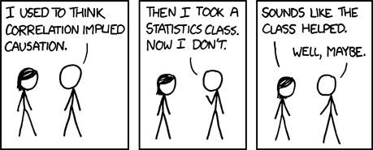
How do we know if we’re doing any good?
Work on M&E / results frameworks seeing massive expansion
Monitoring spending, tracking activities/outputs, assessing performance
Development of programme-level indicators
But, most efforts focus on outputs & spend (IEG 2013), not effectiveness
Many challenges to evaluating effectiveness of interventions
How to measure ‘success’ of adaptation given timescales over which climate change & adaptation will unfold, & changing contexts (climatic, economic…)
How to balance desire for simple, universal indicators with complex realities?
How to attribute observed changes to specific interventions?
https://xkcd.com/552/

Slide 12
What are we measuring?
Purpose of adaptation is to sustain or improve human wellbeing in the face of climate change that might otherwise undermine it
“Climate change ... calls into question the Enlightenment principle that human progress will make the future look better than the past”
UNDP Human Development Report, 2007, p.1
So, ultimately, adaptation success should be measured in terms of development & wellbeing indicators
However, long, complex chains of causality leading from adaptation interventions to improved human wellbeing
Many (most) adaptation interventions concerned with capacity development and/or resilience building
How do we track whether these interventions are helping?

Slide 13
A comprehensive approach to adaptation M&E
Improved institutional capacity for climate risk management (CRM)
Improved human wellbeing, development results, ecosystem functioning despite climate change
Improved resilience of populations, ecosystems, infrastructure, etc.
Better integration of CC into planning, coordination, budgets for CC activities, knowledge, use of climate information, treatment of uncertainty, engagement, awareness of stakeholders
Institutional CRM indicators
Context-specific factors influencing ability to anticipate, plan for, avoid, cope with, recover from & adapt to evolving climate hazards / stresses & shocks
Resilience indicators
Stable or improving health, nutrition economic status, poverty, equality, stability, production, etc.
Standard development indicators + climate data
Monitoring timescales
Based on IIED TAMD Framework (Brooks et al. 2011, 2013, Brooks & Fisher, 2014)

Slide 14
Measuring resilience
Shift in emphasis among donors from adaptation to resilience (why?)
Tend to view resilience in terms of existing or incrementally intensifying climate variability, want simple indicators, vague in definitions, little testing of concepts
Tension between ecology-based definition involving system’s ability to “maintain its essential function, character and structure” & donor focus on change and transformation: bouncing back or ’bouncing back better’? (IPCC – a fudge?)
Abstract concept that needs to be ‘operationalised’ for different contexts
Who is resilient to what, over what timescales, with respect to what consequences? – Need context-specific indicators
UK ICF KPI 4 – No. of people with improved resilience as result of ICF support
Resilience in terms of factors that mediate people’s ability to anticipate, plan for, avoid, cope with, recover from & adapt to evolving climate stresses & shocks
Advocates participatory approaches to identify above factors (contexts, characteristics, assets, etc.) based on past experience, scenario planning
Seen as very challenging due to resource requirements
https://www.gov.uk/government/uploads/system/uploads/attachment_data/file/328254/BRACED-KPI4-methodology-June2014.pdf

Slide 15
Narratives of adaptation success/failure
 | Hazards intensified | Hazards unchanged | Hazards reduced
Improved well-being / reduced losses | Adaptation success | Increased resilience | Constant or increasing vulnerability – luck!
Well-being / losses unchanged | Increased resilience | Vulnerability unchanged | Increased vulnerability
Decline in well-being / greater losses | No or imperfect adaptation | Vulnerability increased | Maladaptation
Aspiration of those engaged in adaptation, but just one possible result – ideal case

Slide 16
Narratives of adaptation success/failure
 | Hazards intensified | Hazards unchanged | Hazards reduced
Improved well-being / reduced losses | Adaptation success | Vulnerability⬇ Resilience⬆ | Constant or increasing vulnerability – luck!
Well-being / losses unchanged | Vulnerability⬇ Resilience⬆ | Vulnerability unchanged | Increased vulnerability
Decline in well-being / greater losses | No or imperfect adaptation | Vulnerability increased | Maladaptation
“Adaptation success space” – clear that adaptation has delivered development gains

Slide 17
Narratives of adaptation success/failure
 | Hazards intensified | Hazards unchanged | Hazards reduced
Improved well-being / reduced losses | Adaptation success | Increased resilience | Constant or increasing vulnerability – luck!
Well-being / losses unchanged | Increased resilience | Vulnerability unchanged | Vulnerability⬆ Resilience⬇
Decline in well-being / greater losses | No or imperfect adaptation | Vulnerability⬆ Resilience⬇ | Maladaptation
“Adaptation failure space” – things should have improved but development has increased risks

Slide 18
Narratives of adaptation success/failure
 | Hazards intensified | Hazards unchanged | Hazards reduced
Improved well-being / reduced losses | Adaptation success | Increased resilience | Constant or increasing vulnerability – luck!
Well-being / losses unchanged | Increased resilience | Vulnerability/resilience unchanged | Vulnerability⬆ Resilience⬇
Decline in well-being / greater losses | No or imperfect adaptation | Vulnerability⬆ Resilience⬇ | Maladaptation
Situation no worse, but adaptation has not delivered

Slide 19
Narratives of adaptation success/failure
 | Hazards intensified | Hazards unchanged | Hazards reduced
Improved well-being / reduced losses | Adaptation success | Increased resilience | Luck?
Well-being / losses unchanged | Increased resilience | Vulnerability/resilience unchanged | Vulnerability⬆ Resilience⬇
Decline in well-being / greater losses | No or imperfect adaptation | Vulnerability⬆ Resilience⬇ | Maladaptation
Is all improvement due to hazard reduction, or is some result of effective adaptation?

Slide 20
Narratives of adaptation success/failure
 | Hazards intensified | Hazards unchanged | Hazards reduced
Improved well-being / reduced losses | Adaptation success | Increased resilience | Luck?
Well-being / losses unchanged | Increased resilience | Vulnerability/resilience unchanged | Vulnerability⬆ Resilience⬇
Decline in well-being / greater losses | No or imperfect adaptation? | Vulnerability⬆ Resilience⬇ | Maladaptation
Would decline in wellbeing have been greater without adaptation?
Very likely scenario – adaptation is not perfect

Slide 21
Narratives of adaptation success/failure
 | Hazards intensified | Hazards unchanged | Hazards reduced
Improved well-being / reduced losses | Adaptation success | Vulnerability⬇ Resilience ⬆ | Luck?
Well-being / losses unchanged | Vulnerability⬇ Resilience⬆ | Vulnerability/resilience unchanged | Vulnerability⬆ Resilience⬇
Decline in well-being / greater losses | No, or imperfect, adaptation? | Vulnerability⬆ Resilience⬇ | Maladaptation
To know where we are in this matrix, we need climate information to tell us how hazards are evolving

Slide 22
Narratives of adaptation success/failure
 | Hazards intensified | Hazards unchanged | Hazards reduced
Improved well-being / reduced losses | Adaptation success | Vulnerability⬇ Resilience⬆ | Luck?
Well-being / losses unchanged | Vulnerability⬇ Resilience⬆ | Vulnerability/resilience unchanged | Vulnerability⬆ Resilience⬇
Decline in well-being / greater losses | No, or imperfect, adaptation? | Vulnerability⬆ Resilience⬇ | Maladaptation
To interrogate extreme cases, we need some sort of counterfactual to know whether adaptation has delivered benefits – climate data

Slide 23
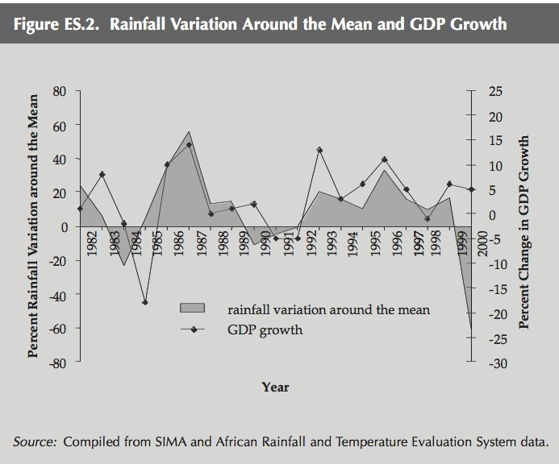
Some uses of climate data
1. Prediction based on temporal correlation
Impact indicators may be well correlated with climate variables
This enables climate variables to be used to model/predict losses/damages, changes in well-being, based on historical relationship
Modelled/predicted changes can be compared with observed changes – deviations from predictions might indicate successful adaptation/decoupling
Need good historical data
Relationships between climate & development variables often complex – statistical correlations may be weak
Left: Relationship between variations in annual rainfall and GDP growth for Ethiopia. From World Bank 2006: Ethiopia: Managing Water Resources to Maximize Sustainable Growth. World Bank Country Water Resources Assistance Strategy.

Slide 24
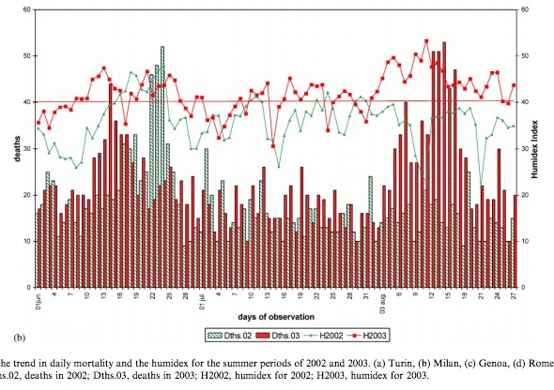
Some uses of climate data
2. Expected losses, damages, costs based on thresholds
Thresholds beyond which people/systems find it hard to cope
E.g. food insecurity rainfall deficit > 1.3 sd below long-term mean (Sahel)*
E.g. excess mortality above certain temp/humidity thresholds
Left: Daily mortality and temperature in Milan for 2002 and 2003 (from Conti et al. 2005); Right: Mortality as % of annual average versus temperature for six cities (from McMichaels et al. 2008); *Tarhule & Woo 1997

Slide 25
The research-development interface
The need for interaction
To design good interventions need much better understanding of climate-environment-human interactions & how climate change may affect them
To assess success of interventions need to understand how things have changed and what role climate change/variability has played – need good climate data
Social & physical sciences both have vital role to play informing & grounding
Challenges
Donors want results quicker than research can deliver them
Finding research partners / contractors difficult - flexibility & cost (FEC) issues
Donors like it simple – academics don’t!
Differences in approaches, presentation, language, expectations
Research inherently uncertain; donors don’t like uncertainty, risk
Benefits
Donor programmes provide huge opportunities for research, testing, learning
Opportunities to influence policy & practice, to demonstrate impact

Slide 26
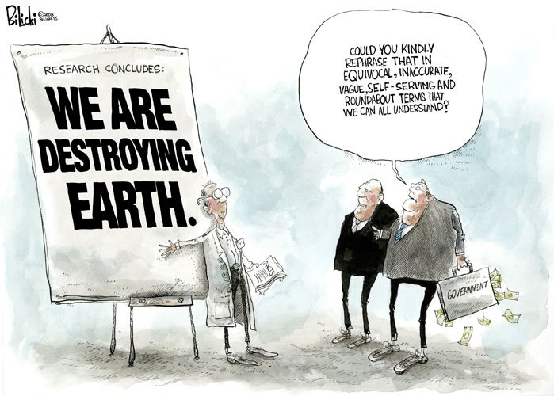
How to speak to decision-makers
Make clear links between climate change & economic/development goals
Identify ‘quick wins’, ‘low/no-regrets’ & ‘win-win’ options (if you can)
Cast in terms of self-interest, not obligations (certainly not moral ones)
Identify criteria for success – targets, etc.
Identify opportunities for accessing finance
Align actions with national priorities
Get ‘buy-in’ from those with most influence, particularly finance & planning ministries
Don’t be too academic!

Slide 27
But we must also challenge
Can private sector deliver adaptation ‘solutions’ to poorest/most vulnerable?
Will capacity building & technological approaches translate into resilience?
Does a focus on resilience miss the need for ’transformational’ adaptation?
Are interventions delivering long-term, sustainable development benefits?
Is adaptation sometimes palliative – what would have happened without it?
Will conservation approaches & good practice be sufficient?
Are we risking longer-term maladaptation for shorter-term benefits?
Are we targeting the right areas with the right actions?
Photo by Matthias Mueller, via Flickr Creative Commons

Slide 28
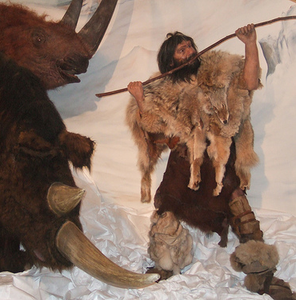
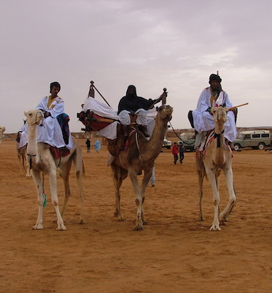
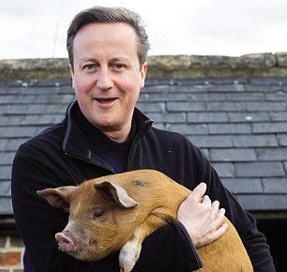
Development & the idea of progress
“As it is undeniable that portions of the human race have existed in a state of savagery, other portions in a state of barbarism and still other portions in a state of civilisation, … these three distinct conditions are connected with one another in a natural as well as necessary sequence of progress.”
Lewis Henry Morgan (1871) Ancient Society: 3-4.
Savagery: hunting & gathering
Barbarism: livestock herding, nomadism, village farming
Civilisation: economic specialisation, cities, states, power, politics
Modernity: elite capture & flogging off public assets to your mates…
Stages of progress defined by Nilsson (tr. 1868), Morgan (1871, 1877). See also Fukuyama (1992). Images from Ben Sutherland¹, Nick Brooks (Sahrawi camel riders, Western Sahara), Matt Barnett (David replica, Caesar’s Palace)¹, Mike de Souza/Crowdfunder. ¹via Flickr Creative Commons

Slide 29
‘Stages’ of social & economic development
Models of linear progress reflected in language of economics & development
Stages of economic development – often invoked by developing country governments as justification for ‘necessary’ growth in emissions¹
Transitions from subsistence agriculture to commercial agriculture² to industrialisation (to service industries)³
Widespread view in many DC govts. that pastoralism is ‘backward’/’primitive’ ^{4,5}
Justification for lack of support/investment in pastoralism⁶
Expansion of agriculture into (often marginal) grazing areas ^{6,7,8}
Settlement of mobile pastoralists – ’civilising’ process
¹Rostow 1960; ² Cooper 1997; ³Grabowski 1995; ⁴Brooks 2006; ⁵Brooks et al 2009; ³Bloch & Foltz (1989); ⁷Brooks 2012a; ⁸Heyd and Brooks 2010
Photo by Nick Brooks

Slide 30
Building on a discredited model
‘In using the phrase “social evolution”, students of the science of man … have mistaken “evolution” for a sort of generalised magic force that does the work of the concrete individual factors that shape the course of history.’ Childe (1951).
Belief in historical progress as misunderstanding of Darwinian evolutionary theory that mistakes evolution for advancement
Cultural trajectories don’t follow neat “progressive” model (archaeology)
Close links between culture & adaptation (e.g. Binford 1962)
‘Universalist’ approaches don’t necessarily work (e.g. colonial development)
Above: “The March of Progress”, 1965. Rudolph Zalinger. Early Man (Time-Life books) (Wikipedia)
Right: Caveman, by Banksy, from Bruce Krasting via Flickr, Creative Commons license.

Slide 31
Rethinking the idea of progress
Development seen as consequence of endogenous social processes that drive progress, with climate change seen as externality (as is environment at large)¹
Ideas of progress have roots in antiquarian narratives of ‘rise of civilisation’²
But strong indications that civilisation not product of progress or abundance, but of adaptation to climate-driven scarcity in Middle Holocene, with costs³⁻⁶
Need to rethink ideas of progress and how development of human societies mediated changes in environmental opportunities & constraints
Otherwise the pursuit of progress will most likely be self-defeating
Changing such fundamental assumptions is challenging but vital…
Graphic source: http://www.designboom.com/project/march-of-progress/
¹Heyd and Brooks 2009 ²Brooks et al. 2009; ³Brooks 2006; ⁴Brooks 2009; ⁵Brooks 2013; ⁶Clarke et al. 2015

Slide 32
References I
Anderson, K. 2015. Duality in climate science. Nature Geoscience 8, 898–900 doi:10.1038/ngeo2559
Brooks, N. 2006. Cultural responses to aridity in the Middle Holocene and increased social complexity. Quaternary International 151: 29-49
Binford, L. R. 1962. Archaeology as anthropology. American Antiquity 28, 217-225.
Brooks, N. 2010. Human responses to climatically-driven landscape change and resource scarcity: Learning from the past and planning for the future. In I. P. Martini and W. Chesworth (eds.) Landscapes and Societies: Selected Cases, pp. 43-66. Springer, Dordrecht, Heidelberg, London, New York, 478 pp.
Brooks 2012a
Brooks 2012b
Brooks, N. 2013. Beyond collapse: climate change and causality during the Middle Holocene Climatic Transition, 6400-5000 years before present (BP). Danish Journal of Geography (in press).
Brooks, N. and Fisher, S. 2014. Tracking Adaptation and Measuring Development: A Step-by-Step Guide. IIED Technical Report, December 2014. (http://pubs.iied.org/10100IIED.html).
Brooks, N., Brown, K. and Grist, N. 2009. Development Futures in the Context of Climate Change: challenging the present and learning from the past. Development Policy Review 27, 741-765.
Brooks, N., Anderson, S., Ayers, J., Burton, I. and Tellam, I. 2011. Tracking Adaptation and Measuring Development. IIED Working Paper No. 1, November 2011. IIED, London/Edinburgh Available from (http://pubs.iied.org/10100IIED.html).
Brooks, N., Anderson, S., Burton, I., Fisher, S., Rai, N. and Tellam, I., 2013. An operational framework for Tracking Adaptation and Measuring Development (TAMD). IIED Climate Change Working Paper No. 5. (Available from http://pubs.iied.org/10038IIED.html)
Childe, V. G. 1951. Social Evolution. Watts & Co. London.
Clarke, J., Brooks, N., Banning, E. B., Miryam Bar-Matthews, M., Campbell, S., Clare, L., Cremaschi, M., di Lernia, S., Drake, N., Gallinaro, M., Manning, S., Nicoll, K., Philip, G., Rosen, S., Schoop, U-D., Tafuri, M. A., Weninger, B. and Zerboni, A. 2015. Climatic Changes and Social Transformations in the Near East and North Africa During the ‘Long’ 4th millennium BC: A Comparative Study of Environmental and Archaeological Evidence. Quaternary Science Reviews. doi:10.1016/j.quascirev.2015.10.003. Available online 19 October 2015
40

Slide 33
References II
Conti, S., Melia, P., Minelia, G., Soliminia, R., Toccacella, V., Vichia, M., Beltrano, C. and Perini, L. 2005. Epidemiologic study of mortality during the Summer 2003 heat wave in Italy, Environmental Research 98, 390–399.
Cooper, F. (1997) ‘Modernizing Bureaucrats, Backward Africans, and the Development Concept’, in F. Cooper and R. Packard (eds), International Development and the Social Sciences, 64-92. University of California Press, Berkeley.
Fukuyama, F. 2002. The End of History and the Last Man (New York: Free Press, 1992
Heyd, T. and Brooks, N. 2009. Exploring cultural dimensions to climate change. In W.N. Adger, I. Lorenzoni and K. O'Brien (eds.) Adapting to Climate Change: Thresholds, Values and Governance, pp. 269-282. Cambridge University Press.
IEG, 2013. Adapting to Climate Change: Assessing World Bank Group Experience. World Bank Group. http://ieg.worldbankgroup.org/content/ieg/en/home/re- ports/climate_change3.html
IPCC, 2014. In: Field, C.B., Barros, V.R., Dokken, D.J., Mach, K.J., Mastrandrea, M.D., Bilir, T.E., Chatterjee, M., Ebi, K.L., Estrada, Y.O., Genova, R.C., Girma, B., Kissel, E.S., Levy, A.N., MacCracken, S., Mastrandrea, P.R., White, L.L. (Eds.), Climate Change 2014: Impacts, Adaptation, and Vulnerability. Part A: Global and Sectoral Aspects. Contribution of Working Group II to the Fifth Assessment Report of the Intergovernmental Panel on Climate Change. Cambridge University Press, Cambridge, United Kingdom and New York, NY, USA, p. 1132.
Jansen, E., Overpeck, J., Briffa, K.R., Duplessy, J.-C., Joos, F., Masson-Delmotte, V., Olago, D., Otto-Bliesner, B., Peltier, W.R., Rahmstorf, S., Ramesh, R., Raynaud, D., Rind, D., Solomina, O., Villalba, R., & Zhang, D. (2007). Palaeocli- mate. In S. Solomon, D. Qin, M. Manning, Z. Chen, M. Marquis, K.B. Averyt, M. Tignor & H.L. Miller (Eds.), Cli- mate Change 2007: The physical science basis. Contribu- tion of Working Group I to the Fourth Assessment Report of the Intergovernmental Panel on Climate Change. Cam- bridge: Cambridge University Press.
McMichael, A. J., Wilkinson, P., Kovats, R. S., Pattenden, S., Hajat, S., Armstrong, B., Vajanapoom, N., Niciu, E. M., Mahomed, H., Kingkeow, C., Kosnik,M., O’Neill, M. S., Isabelle Romieu, I., Ramirez-Aguilar, M., Barreto, M. L., Gouveia, N. and Nikiforov, B. 2008. International study of temperature, heat and urban mortality: the ‘ISOTHURM’ project. Environmentla Epidemiology 37 :1121–1131
40

Slide 34
References III
Manning, K., Timpson, A., 2014. The demographic response to Holocene climate change in the Sahara. Quat. Sci. Rev. 101, 28-35.
Mayewski,P.A., Rohling,E.E., Stager,J.C., Karle N,W.,Maasch,K.W., Meeker,L.D., Meyerson, E.A., Gasse, F., van Kreveld, S., Holmgren, K., Lee-Thorp, J., Rosqvist, G., Rack, F., Staubwasser, M., Schneider, R.R., Steig, E.J., 2004. Holocene climate variability. Quat. Res. 62 (3), 243-255.
Morgan, L. H. 1871. Ancient Society. Reissued 1964 (ed. L. E. White).
Nilssen, S. 1868 (translation). The Primitive Inhabitants of Scandinavia (English translation of Skandinaviska Nordens Urinvanare, pub. 1838-43).
Rostow, W. W. 1960. The Stages of Economic Growth: A Non-Communistic Manifesto. Cambridge: Cambridge University Press.
Sandweiss, D.H., Maasch, K.A., Andrus, C.F.T., Reitz, E.J., Riedinger-Whitmore, M., Richardson III, J.B., Rollins, H.B., 2007. Mid- Holocene climate and culture change in coastal Peru. In: Anderson, D.G., Maasch, K.A., Sandweiss, D.H. (Eds.), Climate Change and Cultural Dynamics: a Global Perspective on Mid- Holocene Transitions. Academic Press, Elsevier, London, pp. 25-50.
Tarhule, A. and Woo, M-K. 1997. Towards an interpretation of historical droughts in northern Nigeria. Climatic Change 37, 601–616,
Thompson, D.P., van Hollen, D., Osborn, G., & Ryane, C. (2006). Did neoglaciation begin as early as 6400 cal years ago? Geological Society of America Abstracts with Pro- grams 38, 236.
40

